Slide 1
















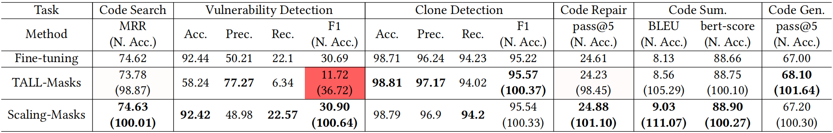
Code Sum.
Features for
Features for
after Scaling
Vul. Detection
Features for
Exract
for
Scale up
Fusion
Rescale
Loss
Maintain
Fusion
Params
1-bit
masks
Direct Max Fusion
融合6个软件工程任务的性能

